Slide 1


RESULTS DECK
Marketing Mix Modeling
How much revenue does each paid channel drive, and what is its return on ad spend?
THE HEADLINE
52.7%
Completed October 21, 2026 · Run sample-m
SAMPLE RUN · BUNDLED SAMPLE DATA, NOT YOUR BUSINESS
of revenue was driven by paid media: $11.7M of $22.2M
Built from the run's stored results. No number is edited by hand.
Notes:
Question: How much revenue does each paid channel drive, and what is its return on ad spend?

Slide 2

EXECUTIVE SUMMARY
SUMMARY
FINDINGS
NEXT STEPS
CONFIDENCE
APPENDIX
Paid media drove 52.7% of revenue, and TikTok returns the most per dollar (4.28x)
MODERATE CONFIDENCE
Sample run on bundled sample data, not your business. Moderate confidence — 99% of independent model specifications agree, but the diagnostics check raised a warning. Review it before acting.
MEDIA-DRIVEN REVENUE
MEDIA SPEND
REVENUE PER MEDIA DOLLAR
BEST RETURN PER DOLLAR
$11.7M
$4.74M
2.47x
4.28x
52.7% of $22.2M total revenue
across 4 channels
media revenue ÷ media spend
TikTok; Meta lowest at 1.29x
KEY FINDINGS
WHAT TO DO NEXT
1
Paid media drove 52.7% of revenue: $11.7M of $22.2M.
TEST FIRST
Shift budget from Meta to Google in stages
2
TikTok returns the most per dollar (4.28x); Meta the least (1.29x).
Meta takes 39.7% of spend but drives 20.7% of media revenue.
TEST FIRST
Run a geo holdout on Meta
3
4
No channel's next-dollar return is settled: each 95% range spans $1.
4 of 5 checks passed (1 with a warning, 1 skipped).
TriaCaf · Marketing Mix Modeling results · run sample-m
SAMPLE DATA
2
Notes:
The findings are the titles of the slides that follow, in order.

Slide 3
APPROACH
SUMMARY
FINDINGS
NEXT STEPS
CONFIDENCE
APPENDIX
The question, the data and the method
What was asked, what it was answered with, and how the answer was checked
THE QUESTION
THE DATA
THE METHOD
How much revenue does each paid channel drive, and what is its return on ad spend?
365 rows · 4 channels
Dataset: ds_sample_mmm
Fingerprint (SHA-256): 8ad836bc3093d0ed…
Model code: fitcore 1.3.0
PyMC-Marketing MMM with adstock + saturation, weakly-informative priors and posterior checks. New runs fit each channel's response curve and next-dollar return with intervals, and a budget reallocation within ±20%. Fans out across adstock specifications.
HOW THIS ANSWER WAS BUILT
Your data
365 rows · 4 channels
3 model specifications
fitted independently, then compared
5 verification checks
4 of 5 checks passed (1 with a warning, 1 skipped)
This deck
7 findings · 3 next steps
The specifications agree 99% on the answer. The Confidence section shows each one and each check.
TriaCaf · Marketing Mix Modeling results · run sample-m
SAMPLE DATA
3

Slide 4
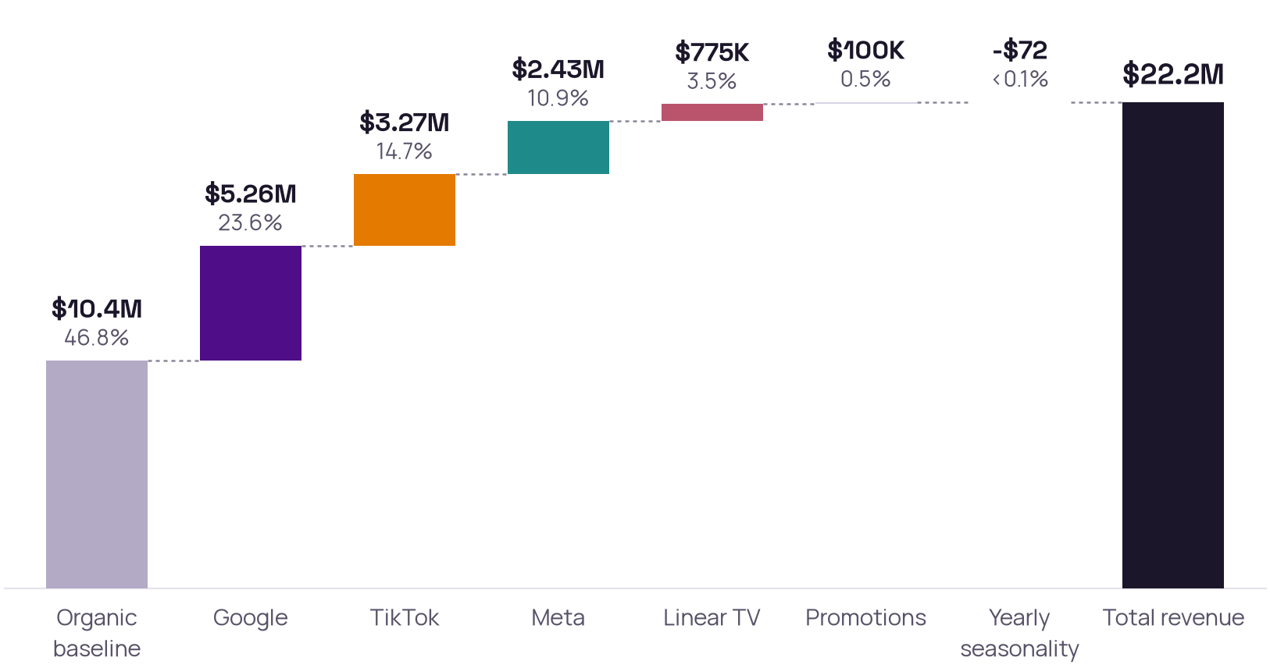
FINDING 1 OF 7 · WHERE REVENUE CAME FROM
SUMMARY
FINDINGS
NEXT STEPS
CONFIDENCE
APPENDIX
Paid media drove 52.7% of revenue: $11.7M of $22.2M
$22,197,940 total revenue over the modelled period
WHAT IT MEANS
$10.4M (46.9%) would have come anyway: the baseline the model expects with no paid media (trend, weekly pattern, organic demand).
Google alone drove $5.26M: 23.7% of all revenue and 44.8% of what media drove.
Promotions ($100K) and Yearly seasonality (-$72) barely move the total.
WHAT TO DO
Judge media on the $11.7M it drove, not on total revenue: the baseline would have come without it.
Each bar adds one source of revenue to the last; the dark bar is the total.
TriaCaf · Marketing Mix Modeling results · run sample-m
SAMPLE DATA
4
Notes:
Source: readout section 'decomposition'.

Slide 5
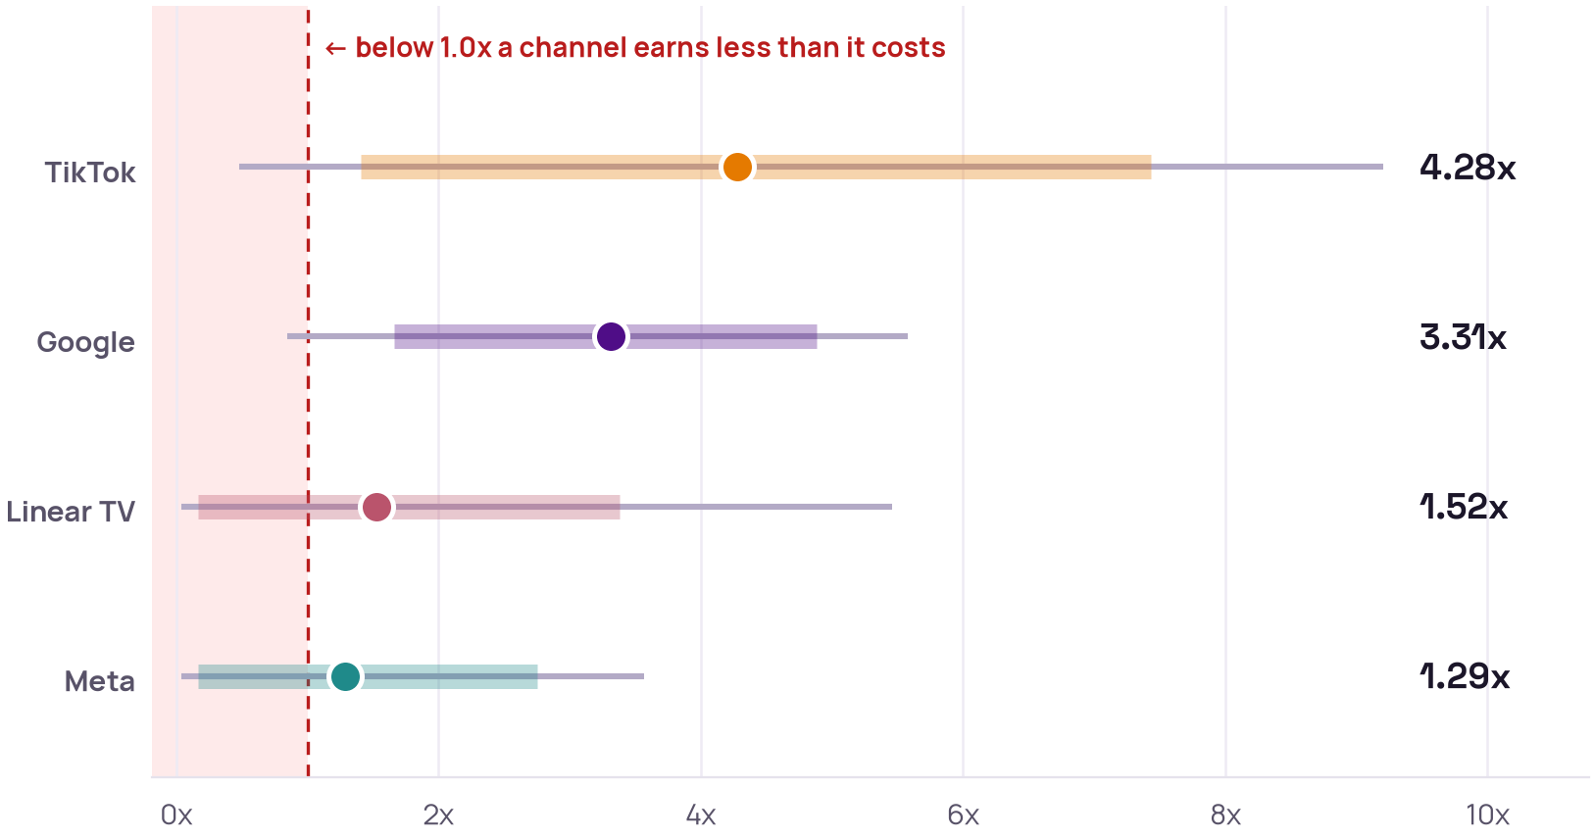
FINDING 2 OF 7 · RETURN ON SPEND BY CHANNEL
SUMMARY
FINDINGS
NEXT STEPS
CONFIDENCE
APPENDIX
Every $1 on TikTok brought back $4.28; on Meta, $1.29
Revenue each channel brought in per dollar spent (ROAS), with its uncertainty
WHAT IT MEANS
MEDIUM CONFIDENCE
TikTok and Google are at least 90% likely to earn more than they cost: their 80% range sits above 1.0x.
Linear TV and Meta can't be called yet: their ranges run from below 1.0x to well above it.
TikTok is the least certain (0.48x to 9.21x): its estimate rests on less evidence.
Why: the ranking is likely, but the channels' ranges overlap
WHAT TO DO
Rely on TikTok and Google; test Linear TV and Meta before counting on their return.
Dot: average estimate. Thick bar: the range it falls in with 80% probability. Thin line: with 95% probability.
TriaCaf · Marketing Mix Modeling results · run sample-m
SAMPLE DATA
5
Notes:
Source: the run's pooled ROAS posteriors (run.posteriors), across every fitted specification. ROAS here is revenue per dollar of spend, not profit.

Slide 6
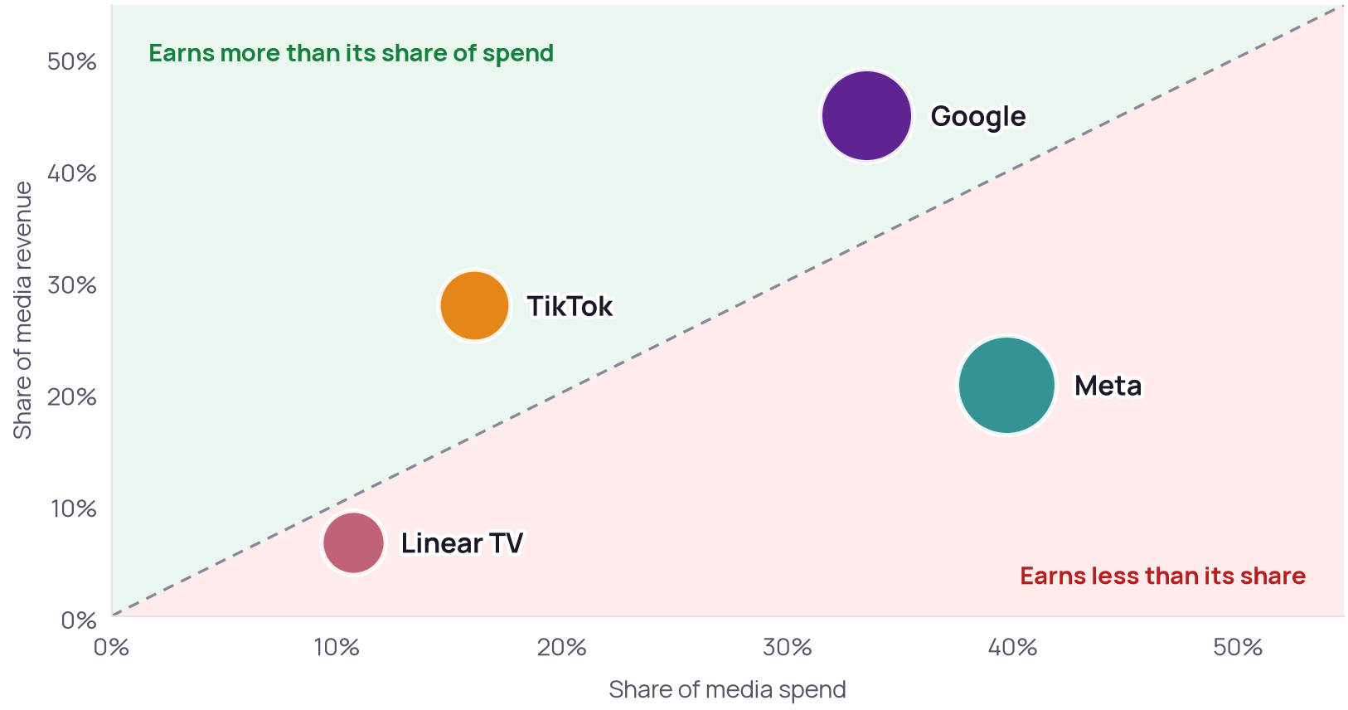
FINDING 3 OF 7 · SPEND AGAINST CONTRIBUTION
SUMMARY
FINDINGS
NEXT STEPS
CONFIDENCE
APPENDIX
Meta takes 39.7% of spend but drives 20.7% of media revenue
Share of spend against share of modelled contribution
WHAT IT MEANS
Google and TikTok earn more than their share: 49.6% of spend, 72.6% of media revenue.
Meta and Linear TV earn less: 50.4% of spend, 27.3% of media revenue.
Read with care: Compares average returns. The response curves below give each channel's fitted next-dollar return, but their bend is weakly identified (see their caveat).
WHAT TO DO
Check each channel's next-dollar return (next slide) before moving budget.
Bubble size: spend. Dashed line: revenue share equals spend share.
TriaCaf · Marketing Mix Modeling results · run sample-m
SAMPLE DATA
6
Notes:
Source: readout section 'efficiency'.

Slide 7
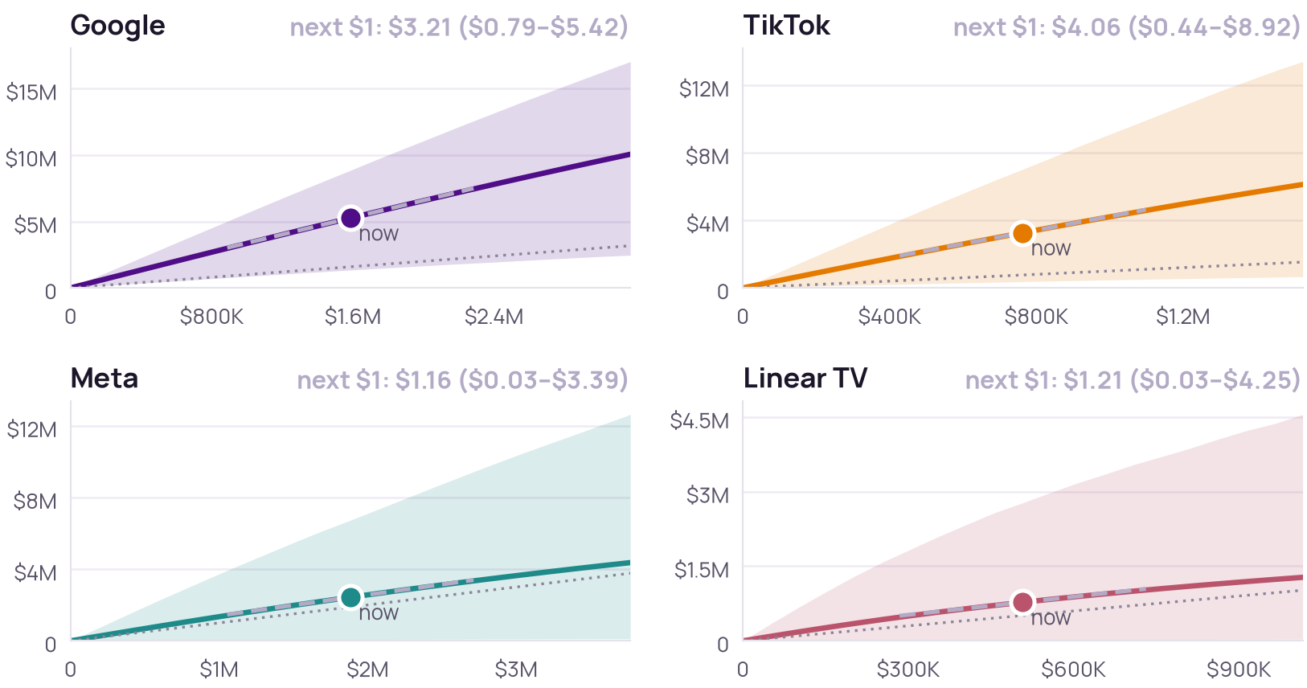
FINDING 4 OF 7 · DIMINISHING RETURNS
SUMMARY
FINDINGS
NEXT STEPS
CONFIDENCE
APPENDIX
No channel's next-dollar return is settled: each 95% range spans $1
Predicted revenue at each level of spend, per channel
WHAT IT MEANS
LOW CONFIDENCE
TikTok has the most headroom on the model's estimate: its next $1 returns $4.06, though anywhere from $0.44 to $8.92.
Google, Meta and Linear TV can't be called: their next-dollar range runs from under $1 to over it.
Meta and Linear TV: the bend is mostly assumed. The data barely narrowed the saturation prior there.
Read these as upper estimates: how fast returns diminish is the hardest part of a mix model to pin down.
WHAT TO DO
Treat next-dollar returns as ranges, not a ranking. Meta is the largest channel whose range spans $1: a geo holdout there would measure it before budget moves.
Line: the model's estimate; shading: its 95% range. Dot: today's spend; dashed: the next dollar's return (green or red when its 95% range, in brackets, is above or below $1, grey when it spans $1). Dotted: revenue equals spend.
TriaCaf · Marketing Mix Modeling results · run sample-m
SAMPLE DATA
7
Notes:
Each posterior draw's curve is the revenue the model attributes to Google over the modelled period had every period's spend been scaled by the same factor; the band is the 95% interval. How fast returns diminish is the least identified part of an MMM. Here 90% of periods' spend sat between 0.76x and 1.22x of its average, a narrow range, so the bend rests on the model's assumed logistic shape and its saturation prior more than on the data. On the bundled benchmark the fitted next-dollar return was 83–97% of average ROAS against a true 17–48%, about 2 to 5 times the true next-dollar return, though each true value was inside its 95% interval. Marginal ROAS here can be overstated the same way. Above 2x of today's spend nothing was computed.
Source: readout sections 'saturation_channel_spend_google', 'saturation_channel_spend_linear_tv', 'saturation_channel_spend_meta', 'saturation_channel_spend_tiktok'.

Slide 8
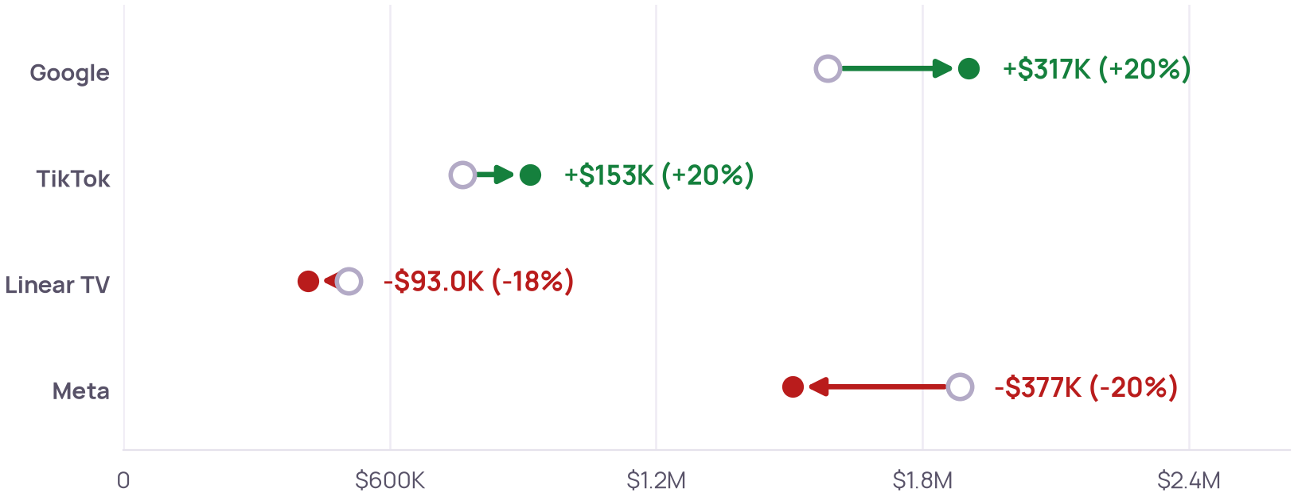
FINDING 5 OF 7 · RECOMMENDED BUDGET SHIFT
SUMMARY
FINDINGS
NEXT STEPS
CONFIDENCE
APPENDIX
Shift spend from Meta (-$377K) and Linear TV (-$93.0K) to Google (+$317K) and TikTok (+$153K), keeping total spend the same
Current against recommended spend per channel; total budget $4.74M
WHAT IT MEANS
LOW CONFIDENCE
Expected revenue change: +$1.05M (95% range -$592K to +$1.98M, which includes a loss) over the modelled period; revenue rises on 89% of the model's draws.
$470K moves (9.9% of the budget); total spend stays $4.74M.
A starting point, not a plan: channels are modelled as independent, and how fast returns diminish is weakly identified, so the expected gain can be overstated.
Why: solved on the fitted curves; revenue rises on 89% of draws, and the 95% range includes a loss
Now
16%
34%
11%
40%
WHAT TO DO
Move budget in stages and check results; Meta's own return is unsettled, so a geo holdout on Meta would confirm the cut first.
Recommended
19%
40%
9%
32%
TikTok
Google
Linear TV
Meta
TriaCaf · Marketing Mix Modeling results · run sample-m
SAMPLE DATA
8
Notes:
The run's own description: Same total spend, each channel within ±20% of its current spend, chosen to maximise expected revenue under the fitted response curves
Source: readout section 'budget_optimizer'.

Slide 9
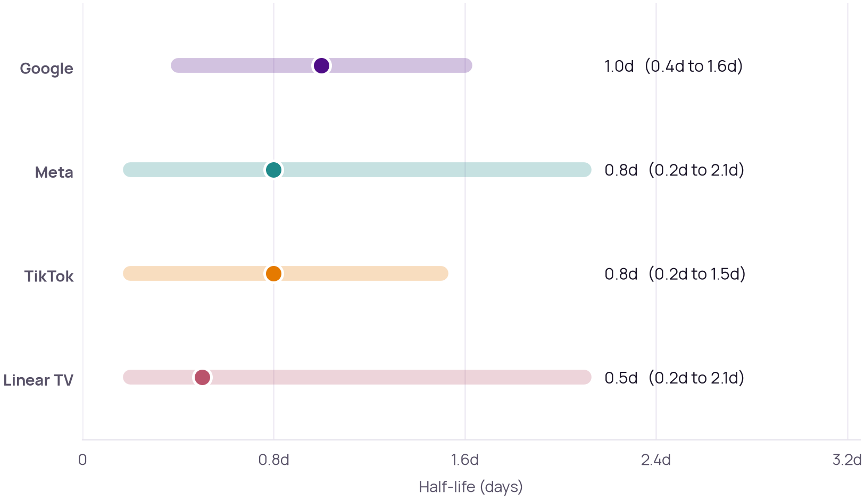
FINDING 6 OF 7 · HOW LONG ADS KEEP WORKING
SUMMARY
FINDINGS
NEXT STEPS
CONFIDENCE
APPENDIX
Ad effects halve within 0.5 to 1.0 days, but 2 of 4 are barely measured
Half-life: the time for an ad's effect on revenue to halve
WHAT IT MEANS
LOW CONFIDENCE
Effects are short-lived: within 3.0 days (three half-lives), seven-eighths of every channel's effect has faded.
Meta and Linear TV are effectively unmeasured: their 95% range is wider than twice the estimate.
Carryover is the hardest number in a marketing mix model to pin down; ROAS is far better measured.
Why: 2 of 4 ranges are wider than twice their estimate
WHAT TO DO
Don't plan flighting or pulsing on these numbers; plan with ROAS, which is better measured.
TriaCaf · Marketing Mix Modeling results · run sample-m
SAMPLE DATA
9
Notes:
Adstock carryover is the least identified quantity in an MMM: on the bundled benchmark ROAS recovers within its interval while decay does not (0.31 estimated against 0.85 true for linear TV). Read these as weak evidence, not as measured decay rates. 2 of 4 channels have a 95% interval wider than twice the estimate — effectively unidentified.
Source: readout section 'carryover'.

Slide 10
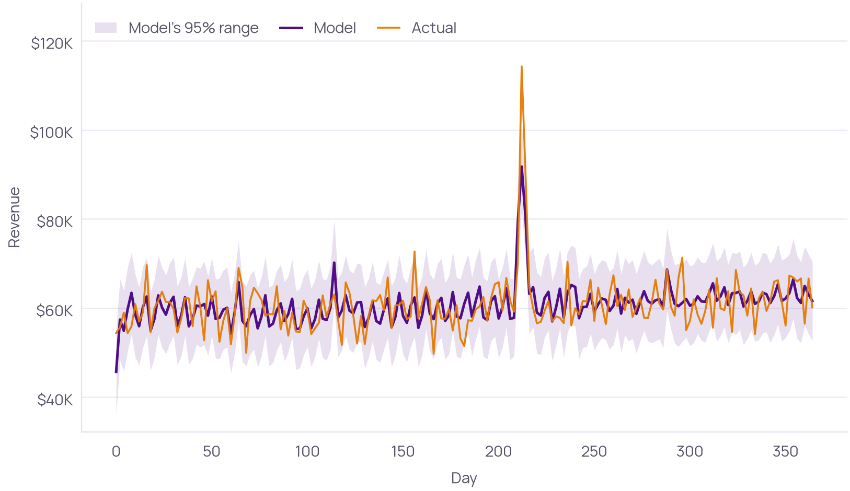
FINDING 7 OF 7 · HOW WELL THE MODEL FITS
SUMMARY
FINDINGS
NEXT STEPS
CONFIDENCE
APPENDIX
The model's daily prediction misses by 5.5% on average, and 96% of days fall inside its 95% range
Posterior predictive mean with 95% interval against observed revenue
WHAT IT MEANS
HIGH CONFIDENCE
Typical miss: 5.5% of a day's revenue (MAPE).
96% of days inside the 95% range (target 95%): well calibrated: its uncertainty is about right.
R² 0.51: the model explains about half of the day-to-day swings; the rest is noise or drivers the data doesn't hold.
In-sample: this shows the model tracks history, not that it predicts new periods.
Why: calibrated range and a small typical miss
WHAT TO DO
Re-check the model as new weeks of data arrive, before relying on it for planning.
TriaCaf · Marketing Mix Modeling results · run sample-m
SAMPLE DATA
10
Notes:
In-sample fit. It shows the model tracks history, not that it predicts held-out periods — see the sensitivity layer for stability across specifications.
Source: readout section 'fit'.

Slide 11
NEXT STEPS
SUMMARY
FINDINGS
NEXT STEPS
CONFIDENCE
APPENDIX
Three moves this analysis supports
Each step follows from a finding in this deck, in the order to take them.
01
TEST FIRST
02
TEST FIRST
03
WATCH
Shift budget from Meta to Google in stages
Run a geo holdout on Meta
Re-fit the model after any shift
Meta takes 39.7% of spend, but its return is unsettled (95% range 0.04x to 3.57x). A geo test measures it directly; the Geo Test Designer pack designs one.
The model's mix moves $377K out of Meta and $317K into Google, keeping spend about flat. Expected revenue change: +$1.05M (95% range -$592K to +$1.98M, which includes a loss); revenue rises on 89% of the model's draws. Shift in stages and measure each step.
How fast returns diminish is weakly identified. A re-run on the new spend levels shows whether the shift paid off and tightens the curves.
TriaCaf · Marketing Mix Modeling results · run sample-m
SAMPLE DATA
11
Notes:
Next steps are written by fixed rules from the run's results: what the numbers support, and what they don't yet settle.

Slide 12
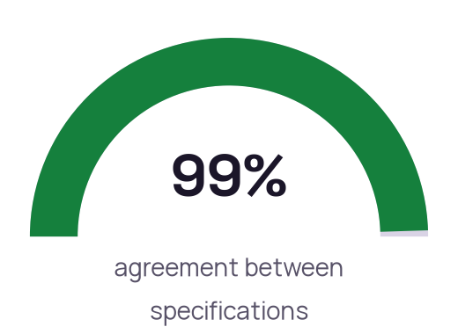
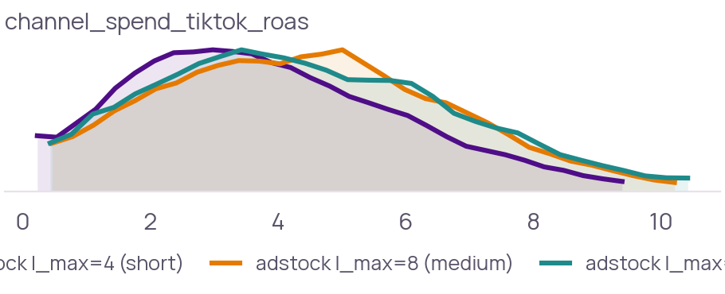
HOW SURE WE ARE · ROBUSTNESS
SUMMARY
FINDINGS
NEXT STEPS
CONFIDENCE
APPENDIX
3 independent model specifications agree 99% on the answer
The same question, answered with different model choices. Agreement means the answer doesn't hinge on any one of them.
WHERE EACH SPECIFICATION PUTS THE ANSWER
WHAT THE COMPARISON FOUND
Three adstock specifications (l_max=4/8/12) recovered blended ROAS of 2.49x, 2.47x, 2.47x. Specs differ by 0.02x on an effect of 2.47x; agreement 0.99. Estimates are stable across adstock priors.
adstock l_max=4 (short)
FITTED
adstock l_max=8 (medium)
FITTED
adstock l_max=12 (long)
NOT CONVERGED
GeometricAdstock(l_max=4) × LogisticSaturation + LinearTrend + WeeklyFourier(3)
rhat_max=1.005 ESS_min=1386 divergences=9 R²=0.518 PI95_coverage=0.96 [converged]
GeometricAdstock(l_max=8) × LogisticSaturation + LinearTrend + WeeklyFourier(3)
rhat_max=1.006 ESS_min=1084 divergences=4 R²=0.508 PI95_coverage=0.97 [converged]
GeometricAdstock(l_max=12) × LogisticSaturation + LinearTrend + WeeklyFourier(3)
rhat_max=1.010 ESS_min=1043 divergences=17 R²=0.507 PI95_coverage=0.96 [NOT converged: 17 divergences (0.5% of draws > 0.5%)]
TriaCaf · Marketing Mix Modeling results · run sample-m
SAMPLE DATA
12
Notes:
Source: the run's subagents and divergence report.

Slide 13




HOW SURE WE ARE · VERIFICATION
SUMMARY
FINDINGS
NEXT STEPS
CONFIDENCE
APPENDIX
4 of 5 checks passed (1 with a warning, 1 skipped)
Every run goes through the same five checks before its numbers are shown.
STEP 1
STEP 2
STEP 3
STEP 4
STEP 5
Execution
Diagnostics
Predictive check
Sensitivity
Human review
Did the fit run on the data it names?
Did the model fitting converge?
Does the model reproduce the data it was fit on?
Do independent model specifications agree?
Did a person on your team review and approve it?
PASSED
PASSED WITH A WARNING
PASSED
PASSED
SKIPPED
365 rows · 4 channels
2/3 converged · max R-hat 1.010 · min ESS 1043 · 30 divergences / 9600 draws
R²=0.511 · MAPE=5.5% · 95% PI coverage=0.97 (target ≈0.95)
agreement 0.99
Sample run: computed by TriaCaf on bundled sample data, so no one in this workspace has reviewed it. Runs on your own data pause here for your approval.
TriaCaf · Marketing Mix Modeling results · run sample-m
SAMPLE DATA
13
Notes:
Source: the run's verification layers.

Slide 14
HOW SURE WE ARE · CAVEATS
SUMMARY
FINDINGS
NEXT STEPS
CONFIDENCE
APPENDIX
What to keep in mind before acting
Each limit below was raised by the model or a verification check, not added afterwards.
CHANNEL EFFICIENCY
Compares average returns. The response curves below give each channel's fitted next-dollar return, but their bend is weakly identified (see their caveat).
ADSTOCK CARRYOVER
Adstock carryover is the least identified quantity in an MMM: on the bundled benchmark ROAS recovers within its interval while decay does not (0.31 estimated against 0.85 true for linear TV). Read these as weak evidence, not as measured decay rates. 2 of 4 channels have a 95% interval wider than twice the estimate — effectively unidentified.
MODEL FIT
In-sample fit. It shows the model tracks history, not that it predicts held-out periods — see the sensitivity layer for stability across specifications.
RESPONSE CURVE: GOOGLE
Each posterior draw's curve is the revenue the model attributes to Google over the modelled period had every period's spend been scaled by the same factor; the band is the 95% interval. How fast returns diminish is the least identified part of an MMM. Here 90% of periods' spend sat between 0.76x and 1.22x of its average, a narrow range, so the bend rests on the model's assumed logistic shape and its saturation prior more than on the data. On the bundled benchmark the fitted next-dollar return was 83–97% of average ROAS against a true 17–48%, about 2 to 5 times the true next-dollar return, though each true value was inside its 95% interval. Marginal ROAS here can be overstated the same way. Above 2x of today's spend nothing was computed.
TriaCaf · Marketing Mix Modeling results · run sample-m
SAMPLE DATA
14
Notes:
Channel efficiency: Compares average returns. The response curves below give each channel's fitted next-dollar return, but their bend is weakly identified (see their caveat).
Adstock carryover: Adstock carryover is the least identified quantity in an MMM: on the bundled benchmark ROAS recovers within its interval while decay does not (0.31 estimated against 0.85 true for linear TV). Read these as weak evidence, not as measured decay rates. 2 of 4 channels have a 95% interval wider than twice the estimate — effectively unidentified.
Model fit: In-sample fit. It shows the model tracks history, not that it predicts held-out periods — see the sensitivity layer for stability across specifications.
Response curve: Google: Each posterior draw's curve is the revenue the model attributes to Google over the modelled period had every period's spend been scaled by the same factor; the band is the 95% interval. How fast returns diminish is the least identified part of an MMM. Here 90% of periods' spend sat between 0.76x and 1.22x of its average, a narrow range, so the bend rests on the model's assumed logistic shape and its saturation prior more than on the data. On the bundled benchmark the fitted next-dollar return was 83–97% of average ROAS against a true 17–48%, about 2 to 5 times the true next-dollar return, though each true value was inside its 95% interval. Marginal ROAS here can be overstated the same way. Above 2x of today's spend nothing was computed.

Slide 15
HOW SURE WE ARE · CAVEATS
SUMMARY
FINDINGS
NEXT STEPS
CONFIDENCE
APPENDIX
What to keep in mind before acting
Each limit below was raised by the model or a verification check, not added afterwards.
RESPONSE CURVE: TIKTOK
Each posterior draw's curve is the revenue the model attributes to TikTok over the modelled period had every period's spend been scaled by the same factor; the band is the 95% interval. How fast returns diminish is the least identified part of an MMM. Here 90% of periods' spend sat between 0.75x and 1.21x of its average, a narrow range, so the bend rests on the model's assumed logistic shape and its saturation prior more than on the data. On the bundled benchmark the fitted next-dollar return was 83–97% of average ROAS against a true 17–48%, about 2 to 5 times the true next-dollar return, though each true value was inside its 95% interval. Marginal ROAS here can be overstated the same way. Above 2x of today's spend nothing was computed.
RESPONSE CURVE: META
Each posterior draw's curve is the revenue the model attributes to Meta over the modelled period had every period's spend been scaled by the same factor; the band is the 95% interval. How fast returns diminish is the least identified part of an MMM. Here 90% of periods' spend sat between 0.76x and 1.22x of its average, a narrow range, so the bend rests on the model's assumed logistic shape and its saturation prior more than on the data. For Meta the data barely narrowed that prior, so this bend is mostly assumed. On the bundled benchmark the fitted next-dollar return was 83–97% of average ROAS against a true 17–48%, about 2 to 5 times the true next-dollar return, though each true value was inside its 95% interval. Marginal ROAS here can be overstated the same way. Above 2x of today's spend nothing was computed.
RESPONSE CURVE: LINEAR TV
Each posterior draw's curve is the revenue the model attributes to Linear TV over the modelled period had every period's spend been scaled by the same factor; the band is the 95% interval. How fast returns diminish is the least identified part of an MMM. Here 90% of periods' spend sat between 0.76x and 1.22x of its average, a narrow range, so the bend rests on the model's assumed logistic shape and its saturation prior more than on the data. For Linear TV the data barely narrowed that prior, so this bend is mostly assumed. On the bundled benchmark the fitted next-dollar return was 83–97% of average ROAS against a true 17–48%, about 2 to 5 times the true next-dollar return, though each true value was inside its 95% interval. Marginal ROAS here can be overstated the same way. Above 2x of today's spend nothing was computed.
BUDGET REALLOCATION
Each channel's curve is the model's estimate of the revenue it would have driven over the modelled period had every period's spend been scaled up or down with the same pattern. The recommendation maximises the posterior mean of that revenue within ±20% per channel; the interval is the same plan evaluated on 240 posterior draws, and includes a loss whenever its lower end is below zero. The bend of the curves is weakly identified, so the expected gain can be overstated: on the bundled benchmark this method's recommended split did raise true revenue, by about a quarter of what the model expected. Channels are modelled as additive, so audience overlap, creative fatigue and auction effects are not captured. Validate a reallocation with a holdout or geo test before committing to it. 1 of the 3 adstock specifications did not meet the convergence thresholds; their draws are included.
TriaCaf · Marketing Mix Modeling results · run sample-m
SAMPLE DATA
15
Notes:
Response curve: TikTok: Each posterior draw's curve is the revenue the model attributes to TikTok over the modelled period had every period's spend been scaled by the same factor; the band is the 95% interval. How fast returns diminish is the least identified part of an MMM. Here 90% of periods' spend sat between 0.75x and 1.21x of its average, a narrow range, so the bend rests on the model's assumed logistic shape and its saturation prior more than on the data. On the bundled benchmark the fitted next-dollar return was 83–97% of average ROAS against a true 17–48%, about 2 to 5 times the true next-dollar return, though each true value was inside its 95% interval. Marginal ROAS here can be overstated the same way. Above 2x of today's spend nothing was computed.
Response curve: Meta: Each posterior draw's curve is the revenue the model attributes to Meta over the modelled period had every period's spend been scaled by the same factor; the band is the 95% interval. How fast returns diminish is the least identified part of an MMM. Here 90% of periods' spend sat between 0.76x and 1.22x of its average, a narrow range, so the bend rests on the model's assumed logistic shape and its saturation prior more than on the data. For Meta the data barely narrowed that prior, so this bend is mostly assumed. On the bundled benchmark the fitted next-dollar return was 83–97% of average ROAS against a true 17–48%, about 2 to 5 times the true next-dollar return, though each true value was inside its 95% interval. Marginal ROAS here can be overstated the same way. Above 2x of today's spend nothing was computed.
Response curve: Linear TV: Each posterior draw's curve is the revenue the model attributes to Linear TV over the modelled period had every period's spend been scaled by the same factor; the band is the 95% interval. How fast returns diminish is the least identified part of an MMM. Here 90% of periods' spend sat between 0.76x and 1.22x of its average, a narrow range, so the bend rests on the model's assumed logistic shape and its saturation prior more than on the data. For Linear TV the data barely narrowed that prior, so this bend is mostly assumed. On the bundled benchmark the fitted next-dollar return was 83–97% of average ROAS against a true 17–48%, about 2 to 5 times the true next-dollar return, though each true value was inside its 95% interval. Marginal ROAS here can be overstated the same way. Above 2x of today's spend nothing was computed.
Budget reallocation: Each channel's curve is the model's estimate of the revenue it would have driven over the modelled period had every period's spend been scaled up or down with the same pattern. The recommendation maximises the posterior mean of that revenue within ±20% per channel; the interval is the same plan evaluated on 240 posterior draws, and includes a loss whenever its lower end is below zero. The bend of the curves is weakly identified, so the expected gain can be overstated: on the bundled benchmark this method's recommended split did raise true revenue, by about a quarter of what the model expected. Channels are modelled as additive, so audience overlap, creative fatigue and auction effects are not captured. Validate a reallocation with a holdout or geo test before committing to it. 1 of the 3 adstock specifications did not meet the convergence thresholds; their draws are included.

Slide 16
HOW SURE WE ARE · CAVEATS
SUMMARY
FINDINGS
NEXT STEPS
CONFIDENCE
APPENDIX
What to keep in mind before acting
Each limit below was raised by the model or a verification check, not added afterwards.
DIAGNOSTICS CHECK
2/3 converged · max R-hat 1.010 · min ESS 1043 · 30 divergences / 9600 draws
TriaCaf · Marketing Mix Modeling results · run sample-m
SAMPLE DATA
16
Notes:
Diagnostics check: 2/3 converged · max R-hat 1.010 · min ESS 1043 · 30 divergences / 9600 draws

Slide 17
APPENDIX · THE NUMBERS
SUMMARY
FINDINGS
NEXT STEPS
CONFIDENCE
APPENDIX
Channel efficiency
Share of spend against share of modelled contribution
Channel | Spend | Spend % | Contribution | Contribution % | ROAS | Read
Google | $1,586,522 | 33.5% | $5,255,619 | 44.8% | 3.31x | under-invested
TikTok | $763,111 | 16.1% | $3,265,320 | 27.8% | 4.28x | under-invested
Meta | $1,884,457 | 39.7% | $2,431,005 | 20.7% | 1.29x | over-invested
Linear TV | $508,029 | 10.7% | $774,809 | 6.6% | 1.52x | over-invested
READ WITH CARE
Compares average returns. The response curves below give each channel's fitted next-dollar return, but their bend is weakly identified (see their caveat).
TriaCaf · Marketing Mix Modeling results · run sample-m
SAMPLE DATA
17
Notes:
Source: readout section 'efficiency'.

Slide 18
APPENDIX · THE NUMBERS
SUMMARY
FINDINGS
NEXT STEPS
CONFIDENCE
APPENDIX
Budget reallocation
The model's recommended mix, as the run reported it; next-dollar returns with their 95% ranges
Channel | Current $ | Recommended $ | Change | Next $1 now | Next $1 after | Action
TikTok | $763,111 | $915,733 | +20.0% | 4.06x [0.44, 8.92] | 3.94x [0.40, 8.70] | increase (at the +20% limit)
Google | $1,586,522 | $1,903,827 | +20.0% | 3.21x [0.79, 5.42] | 3.14x [0.75, 5.33] | increase (at the +20% limit)
Linear TV | $508,029 | $414,994 | −18.3% | 1.21x [0.03, 4.25] | 1.32x [0.03, 4.58] | decrease
Meta | $1,884,457 | $1,507,565 | −20.0% | 1.16x [0.03, 3.39] | 1.22x [0.03, 3.47] | decrease (at the −20% limit)
READ WITH CARE
Each channel's curve is the model's estimate of the revenue it would have driven over the modelled period had every period's spend been scaled up or down with the same pattern. The recommendation maximises the posterior mean of that revenue within ±20% per channel; the interval is the same plan evaluated on 240 posterior draws, and includes a loss whenever its lower end is below zero. The bend of the curves is weakly identified, so the expected gain can be overstated: on the bundled benchmark this method's recommended split did raise true revenue, by about a quarter of what the model expected. Channels are modelled as additive, so audience overlap, creative fatigue and auction effects are not captured. Validate a reallocation with a holdout or geo test before committing to it. 1 of the 3 adstock specifications did not meet the convergence thresholds; their draws are included.
TriaCaf · Marketing Mix Modeling results · run sample-m
SAMPLE DATA
18
Notes:
Source: readout section 'budget_optimizer'.

Slide 19
APPENDIX · ESTIMATES
SUMMARY
FINDINGS
NEXT STEPS
CONFIDENCE
APPENDIX
Parameter estimates
Posterior mean and credible intervals for each parameter the run reported.
Parameter | Mean | 80% interval | 95% interval
channel_spend_meta_roas | 1.29 | 0.169 to 2.754 | 0.039 to 3.569
channel_spend_google_roas | 3.313 | 1.658 to 4.881 | 0.846 to 5.577
channel_spend_tiktok_roas | 4.279 | 1.407 to 7.431 | 0.48 to 9.206
channel_spend_linear_tv_roas | 1.525 | 0.163 to 3.381 | 0.038 to 5.459
TriaCaf · Marketing Mix Modeling results · run sample-m
SAMPLE DATA
19

Slide 20
APPENDIX · ABOUT THIS ANALYSIS
SUMMARY
FINDINGS
NEXT STEPS
CONFIDENCE
APPENDIX
How to reproduce and verify this run
RUN
sample-marketing-mix
VERIFY IT YOURSELF
The model card is a signed record of this run: its data, specifications, checks and results.
Open it from the run's page in the portal, then check its signature against the public keys the TriaCaf API lists at /model-cards/public-keys.
The dataset fingerprint and model code version identify exactly what was fitted, so the run can be repeated on the same inputs.
DECISION PACK
Marketing Mix Modeling (mmm)
STARTED
October 21, 2026
COMPLETED
October 21, 2026
MODEL CODE
fitcore 1.3.0
DATASET FINGERPRINT
8ad836bc3093d0edfe78…c8dc6ce1
Sample run: computed by TriaCaf on bundled sample data. It describes no real business.
TriaCaf · Marketing Mix Modeling results · run sample-m
SAMPLE DATA
20
Notes:
Dataset fingerprint (SHA-256): 8ad836bc3093d0edfe781b8d6c9f7dc21e8404848ab3a8a60e142f29c8dc6ce1

